Slide 1


Take Home Test II
Anthony Ramos
CSC342/43 – Spring 2021

Slide 2

Objective
Analyze Stack Frames using recursion across three different architecture sets.

Slide 3
Factorial

Slide 4
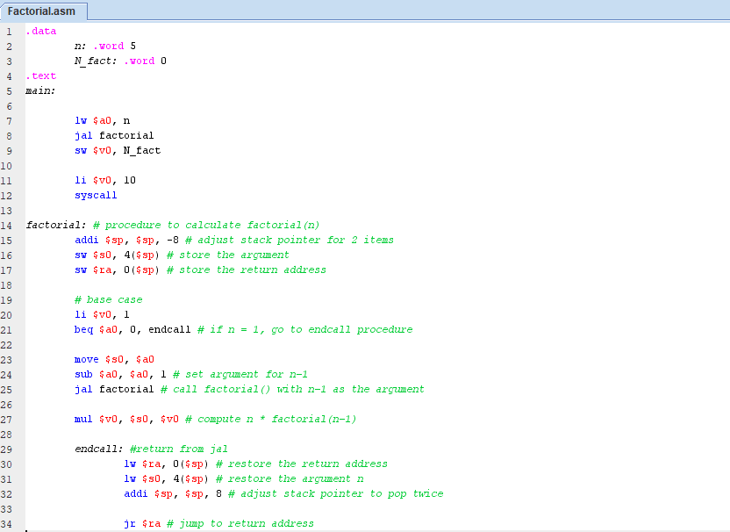
MIPS Assembly on MARS Simulator
Figure 1: factorial.asm

Slide 5
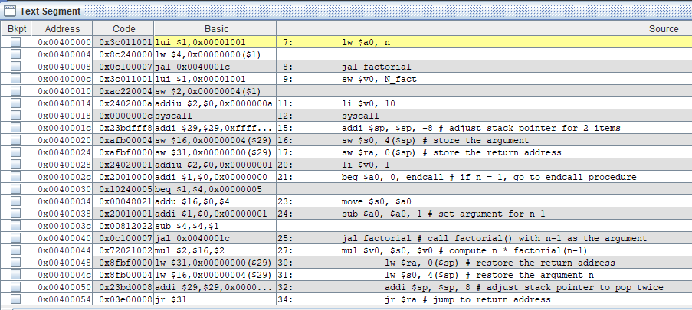
MIPS Assembly on MARS Simulator
Figure 2:

Slide 6
MIPS Assembly on MARS Simulator
Return address of factorial()
Address: 0x7FFFEFE4
Return address of factorial()
Address: 0x7FFFEFCC
Return address of factorial()
Address: 0x7FFFEFD4
Return address of factorial()
Address: 0x7FFFEFDC
Argument at level fact(1)
Address: 0x7FFFEFD0
Value: 1
Argument at level fact(2)
Address: 0x7FFFEFD8
Value: 2
Return address of factorial()
Address: 0x7FFFEFEC
Return address of main()
Address: 0x7FFFEFF4
Argument at level fact(3)
Address: 0x7FFFEFE0
Value: 3
Argument at level fact(4)
Address: 0x7FFFEFE8
Value: 4
Argument at level fact(5)
Address: 0x7FFFEFF0
Value: 5
Figure 3: All argument and return address values

Slide 7
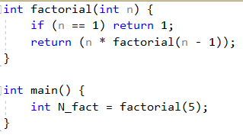
Intel X86 MS Visual Studio
Figure 4: factorial.cpp

Slide 8
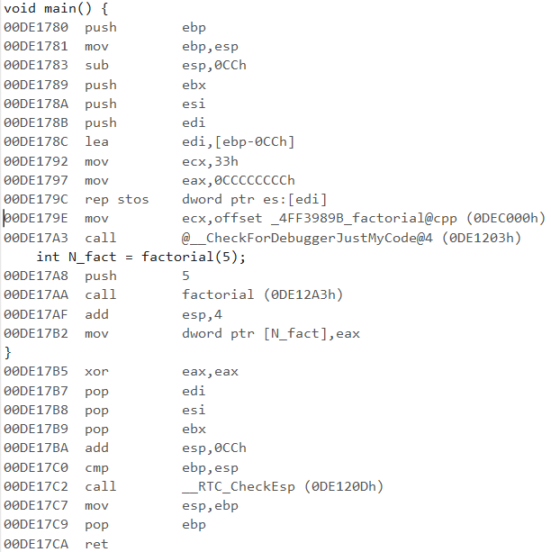
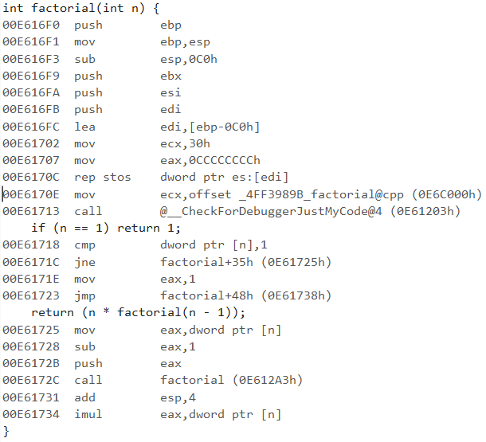
Intel X86 MS Visual Studio
Figure 5: Assembly code for main() and factorial()

Slide 9
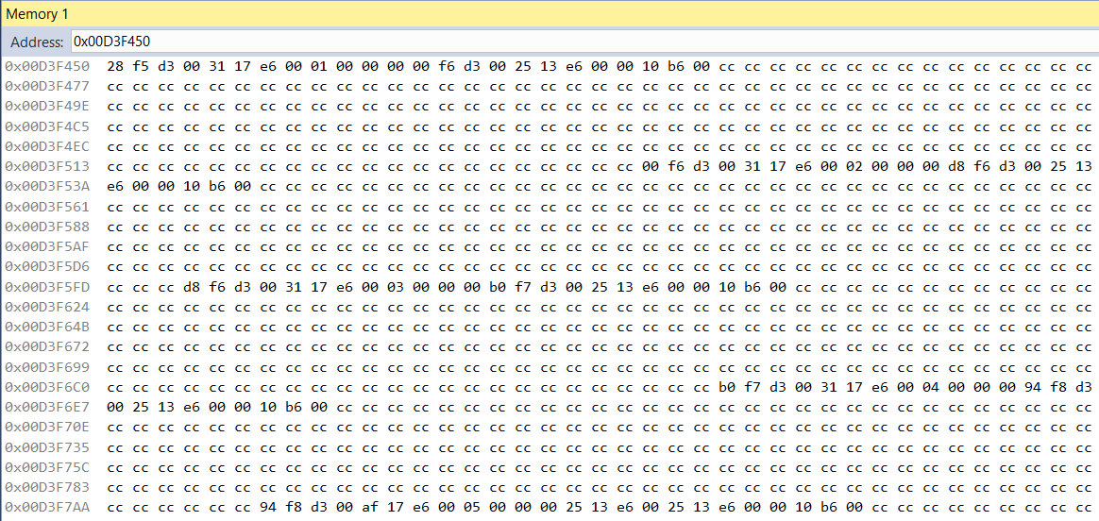
Intel X86 MS Visual Studio
factorial(1)
factorial(2)
factorial(3)
factorial(4)
factorial(5)
Figure 7: Stack frames of entire program

Slide 10
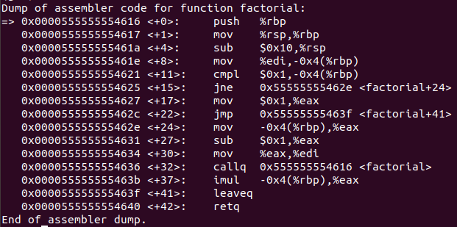
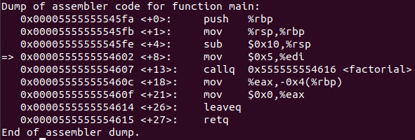
IntelX86 64-Bit (Linux GDB)
factorial()
main()
Figure 8: Disassembly of factorial.cpp

Slide 11
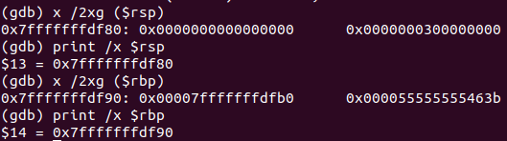
IntelX86 64-Bit (Linux GDB)
new stack pointer
Argument value at current level
Old base pointer
Return addresses
new base pointer
Figure 9: An instance of a Stack Frame

Slide 12
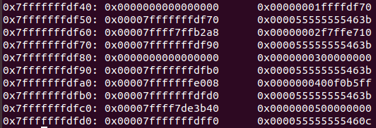
IntelX86 64-Bit (Linux GDB)
Stack Pointer Argument 1
Base Pointer
Return Address
Figure 10: Stack frames of entire program

Slide 13
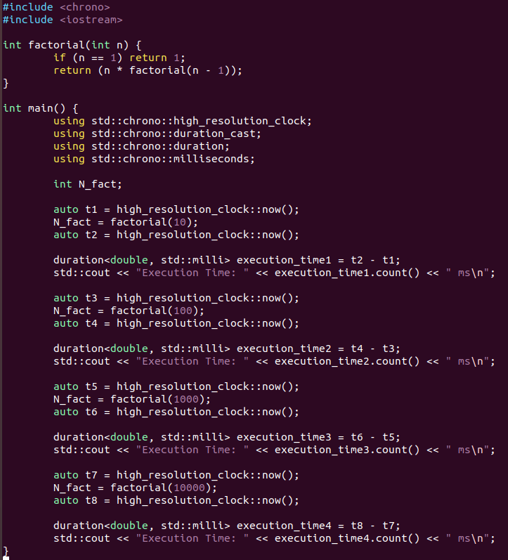
Execution time for various inputs n
Factorial(10)
Factorial(100)
Factorial(1000)
Factorial(10000)
Figure 11: Modified factorial.cpp program to calculate execution time

Slide 14
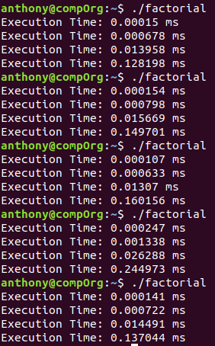
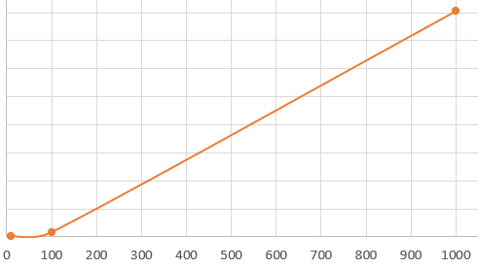
Execution time for various inputs n
Figure 12: Several execution times and a plot

